Slide 1
Binary Parallel Adder;
Binary Adder-Subtractor;
Binary Multiplier;
Magnitude Comparator;
Code Converters

Slide 2
Binary Parallel Adder
A binary adder is a digital circuit that produces the arithmetic sum of two binary numbers.
It can be constructed with full adders connected in cascade, with the output carry from each full adder connected to the input carry of the next full adder in the chain.

Slide 3
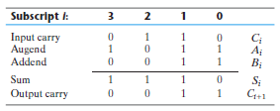
Example:
Consider the two binary numbers A = 1011 and B = 0011. Their sum S = 1110 is formed with the four-bit adder as follows:

Slide 4
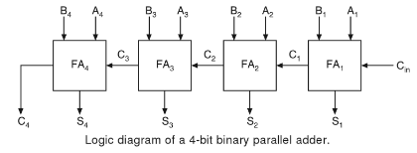
Figure shows the interconnection of four full-adder (FA) circuits to provide a 4-bit binary parallel adder.

Slide 5
The augend bits of A and the addend bits of B are designated by subscript numbers from right to left, with subscript 1 denoting the least significant bit.
The carries are connected in a chain through the full adders. The input carry to the adder is C_{in}, and it ripples through the full adders to the output carry C₄.
The S outputs generate the required sum bits.

Slide 6
An n-bit adder requires n full adders, with each output carry connected to the input carry of the next higher order full adder. The input carry to the least significant position is fixed at 0.
The parallel adder, in which the carry-out of each full-adder is the carry-in to the next most significant adder is called a ripple carry adder.

Slide 7
Binary Parallel Subtractor
The subtraction of unsigned binary numbers can be done most conveniently by means of complements.
Remember that the subtraction A - B can be done by taking the 2’s complement of B and adding it to A .
The 2’s complement can be obtained by taking the 1’s complement and adding 1 to the least significant pair of bits.

Slide 8
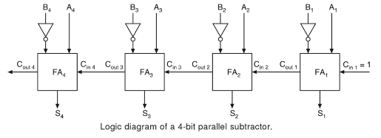
The 1’s complement can be implemented with inverters, and a 1 can be added to the sum through the input carry.

Slide 9
The circuit for subtracting A - B consists of an adder with inverters placed between each data input B and the corresponding input of the full adder.
The input carry C_{in} must be equal to 1 when subtraction is performed.
The operation thus performed becomes A, plus the 1’s complement of B, plus 1. This is equal to A plus the 2’s complement of B.
For unsigned numbers, that gives A - B if A ≥ B or the 2’s complement of (B - A) if A < B.

Slide 10
Binary Adder-Subtractor
The addition and subtraction operations can be combined into one circuit with one common binary adder by including an exclusive-OR gate with each full adder.
A 4-bit adder-subtractor circuit is shown in Fig.
The mode input M controls the operation.
When M = 0, the circuit is an adder, and when M = 1, the circuit becomes a subtractor.

Slide 11
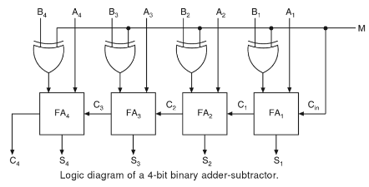

Slide 12
Each exclusive-OR gate receives input M and one of the inputs of B .
When M = 0, we have B Ꚛ 0 = B. The full adders receive the value of B , the input carry is 0, and the circuit performs A plus B.
When M = 1, we have B Ꚛ 1 = B’ and C_{in} = 1. The B inputs are all complemented and a 1 is added through the input carry. The circuit performs the operation A plus the 2’s complement of B.

Slide 13
Binary Multiplier
Multiplication of binary numbers is performed in the same way as multiplication of decimal numbers.
The multiplicand is multiplied by each bit of the multiplier, starting from the least significant bit.
Each such multiplication forms a partial product. Successive partial products are shifted one position to the left.
The final product is obtained from the sum of the partial products.

Slide 14
Consider the multiplication of two 2-bit numbers as shown in Fig.
The multiplicand bits are B₁ and B₀, the multiplier bits are A₁ and A₀, and the product is C₃C₂C₁C₀.
The first partial product is formed by multiplying B₁B₀ by A₀.
The multiplication of two bits such as A₀ and B₀ produces a 1 if both bits are 1; otherwise, it produces a 0. This is identical to an AND operation. Therefore, the partial product can be implemented with AND gates as shown in the diagram.

Slide 15
The second partial product is formed by multiplying B₁B₀ by A₁ and shifting one position to the left.
The two partial products are added with two half-adder (HA) circuits.
Usually, there are more bits in the partial products and it is necessary to use full adders to produce the sum of the partial products.
Note that the least significant bit of the product does not have to go through an adder, since it is formed by the output of the first AND gate.

Slide 16
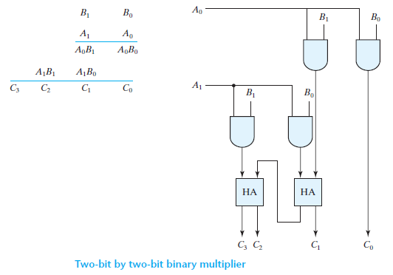

Slide 17
A combinational circuit binary multiplier with more bits can be constructed in a similar fashion.
A bit of the multiplier is ANDed with each bit of the multiplicand in as many levels as there are bits in the multiplier.
The binary output in each level of AND gates is added with the partial product of the previous level to form a new partial product.
The last level produces the product.
For J multiplier bits and K multiplicand bits, we need (J × K) AND gates and (J - 1)K-bit adders to produce a product of (J + K) bits.

Slide 18
Comparators
A comparator is a logic circuit, used to compare the magnitudes of two binary numbers.
The comparison of two numbers is an operation that determines whether one number is greater than, less than, or equal to the other number.
There are two common types of comparators.
  Equality Comparator
  Magnitude Comparator

Slide 19
Equality Comparator
An equality comparator produces a single output indicating whether A is equal to B.
Two binary numbers are equal, if and only if all their corresponding bits coincide.
For example, two 4-bit binary numbers, A₃A₂A₁A₀ and B₃B₂B₁B₀ are equal, if and only if, A₃ = B₃, A₂ = B₂, A₁ = B₁, and A₀ = B₀.

Slide 20
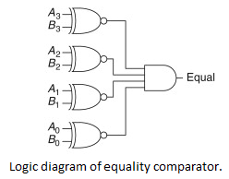
The equality can be expressed logically with an exclusive-NOR function as
EQUALITY = (A₃ ʘ B₃) (A₂ ʘ B₂) (A₁ ʘ B₁) (A₀ ʘ B₀)

Slide 21
Magnitude Comparator
A magnitude comparator is a combinational circuit that compares two numbers A and B and determines their relative magnitudes.
The outcome of the comparison is specified by three binary variables that indicate whether A > B, A = B, or A < B.

Slide 22
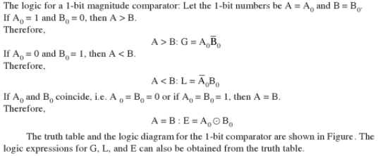
1-bit Magnitude Comparator

Slide 23
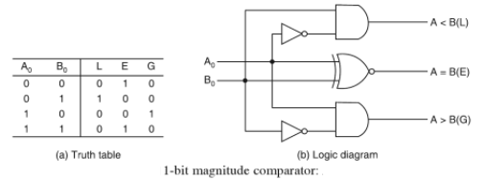

Slide 24
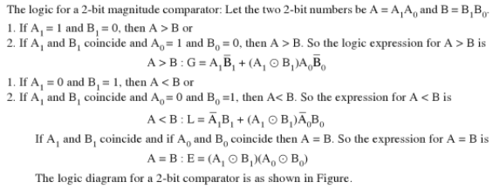
2-bit Magnitude Comparator

Slide 25
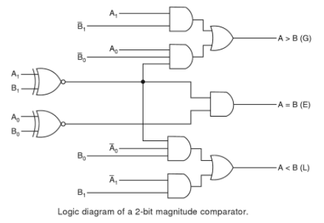

Slide 26
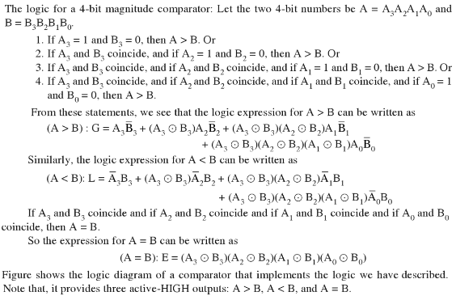
4-bit Magnitude Comparator

Slide 27
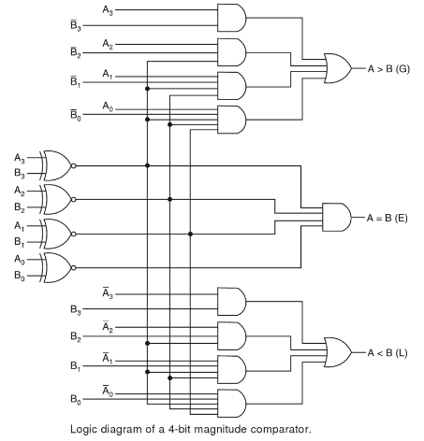

Slide 28
Code Converters
A code converter is a logic circuit whose inputs are bit patterns representing numbers (or characters) in one code and whose outputs are the corresponding representations in a different code.
Code converters are usually multiple output circuits.
To convert from binary code A to binary code B, the input lines must supply the bit combination of elements as specified by code A and the output lines must generate the corresponding bit combination of code B. A combinational circuit performs this transformation by means of logic gates.

Slide 29
Design of a 4-bit Binary-to-Gray Code Converter.
The input to the 4-bit binary-to-Gray code converter circuit is a 4-bit binary and the output is a 4-bit Gray code. There are 16 possible combinations of 4-bit binary input and all of them are valid. Hence no don’t cares.
The 4-bit binary code and the corresponding output Gray code are shown in the conversion table.

Slide 30
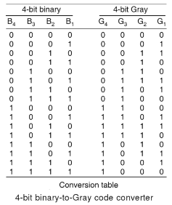

Slide 31

From the conversion table, we observe that expressions for the outputs G₄, G₃, G₂, and G₁ are as follows:

Slide 32
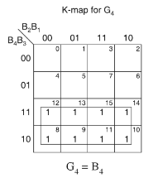
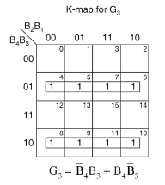
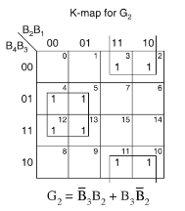
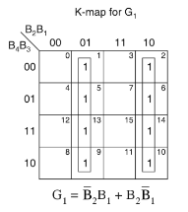

Slide 33

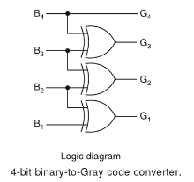
The minimal expressions for the outputs obtained from the K-map are:

Slide 34
Design of a 4-bit Gray-to-Binary Code Converter.
The input to the 4-bit Gray-to-binary code converter circuit is a 4-bit Gray and the output is a 4-bit binary code. There are 16 possible combinations of 4-bit Gray input and all of them are valid. Hence no don’t cares.
The 4-bit Gray code and the corresponding output binary code are shown in the conversion table.

Slide 35
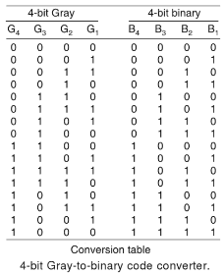

Slide 36

From the conversion table, we observe that expressions for the outputs B₄, B₃, B₂, and B₁ are as follows:

Slide 37
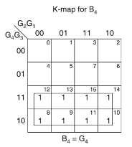
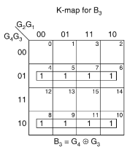
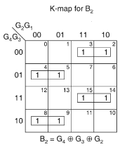
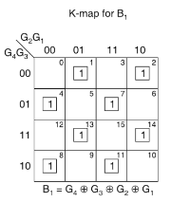

Slide 38
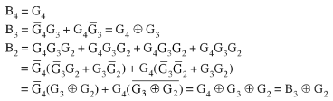
The minimal expressions for the outputs obtained from the K-map are:

Slide 39
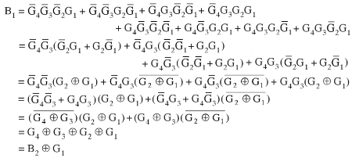

Slide 40

